Slide 1












Potato’s Way to Kitchen

Slide 2
What does the game do?
Nothing.
-------------- jk.
Goal: Find the kitchen keys within a minute.
Interaction through voice commands: go left, right, go to the table, what do you think in here, can you open it an have a look? …etc.
Batata wins when you find the kitchen key and command him to “take it”.
Batata loses when 1 minute has already passed, then he will get depressed and loses the party spirit.

Slide 3
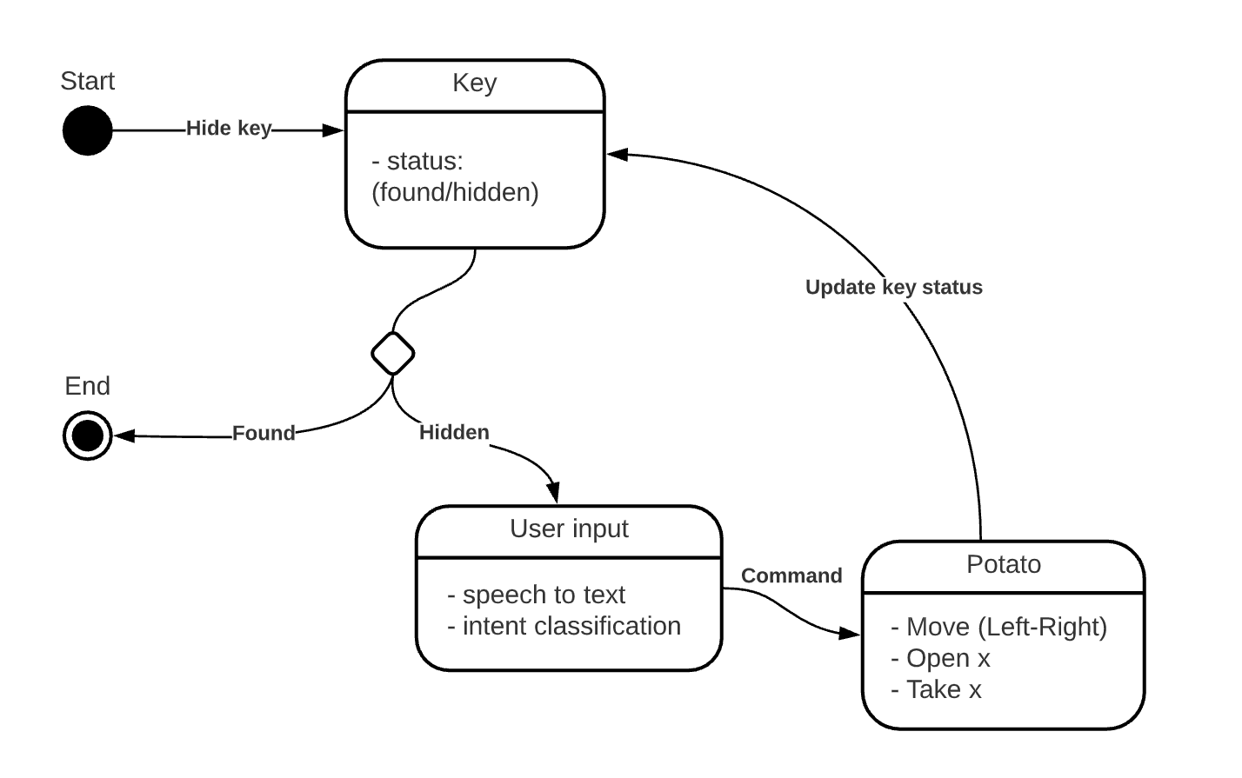
Technical Details
Basically, copy-pasting Vlad’s xstate-react template.
GUI: HTML/CSS
Backend: TypeScript (Xstate) + JavaScript (React.js)
Voice Commands: React-speech-kit
Interaction with GUI through DOM (Document Object Model)

Slide 4
Challenges
Confusion during the intent classification:
E.g., Go to the table to have a look
Correct intent: “Move”
Predicted intent: “Check” or “Open”
Fixed: added more training data + when the confidence is below a certain threshold, it asks a clarification question.
Complex outputs didn’t fit in a single state:
Many conditions and dependencies with the current state of HTML elements.
Fixed: added “customized” events.

Slide 5
Link to the Labs
Lab I → Training a Rasa model
Lab II → Planning the state chart and Invoking a service
Lab III → Tried to play around with the potato’s voice [didn’t work out]
Lab VI → Timeouts for the countdown and re-prompts.
Lab V → Absolutely nothing.

Slide 6
Future Work
Responsive design.
Model can always be enhanced with more training data.
Complex commands e.g., `take whatever is in the drawer` == “Move” + “Open” + “Take”.
Use more appropriate architecture e.g., Model-View-Controller (MVC) pattern.

Slide 7

DEMO

Slide 8
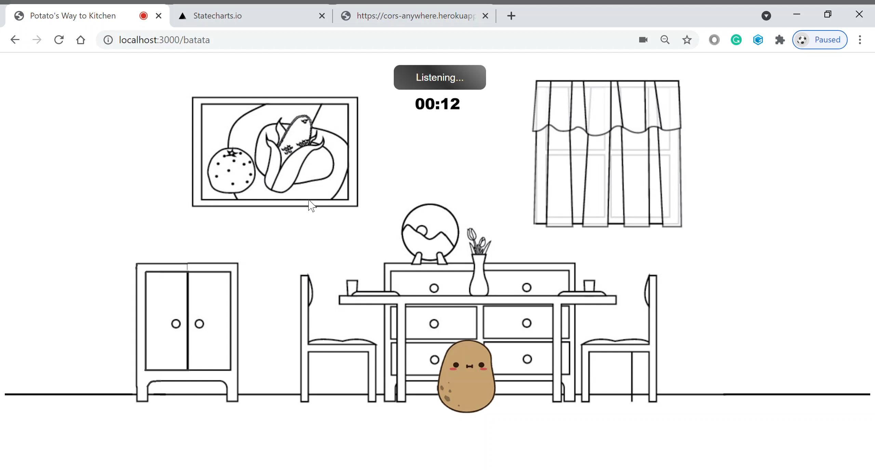
Scenario 1 (Lose like a rotten potato)

Slide 9
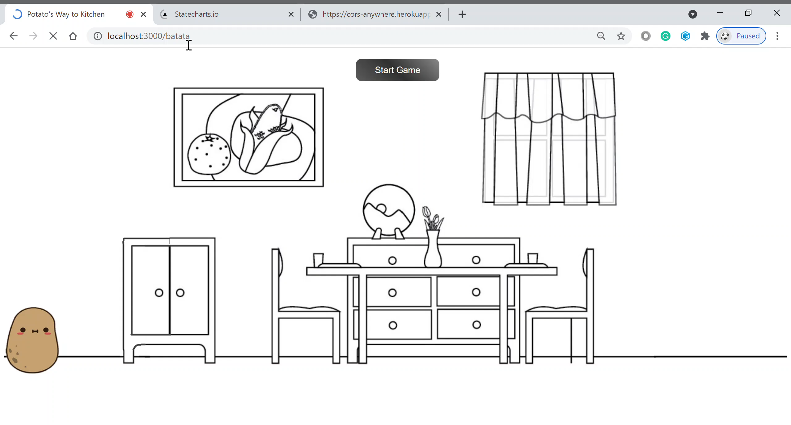
Scenario 2 (Win like a sweet potato)

